Slide 1


Welcome to imademethink
Webpage Layout Testing using Galen Framework

Slide 2
Agenda
What is Galen Framework?
Installation Junit/ TestNG/ Maven
gspec language
Simple feature overview:
Element/ Object Attributes – Positional etc
Element/ Object Attributes – CSS, Text etc
Element/ Object groups and page sections
Image compare
Different browser size
Testing using Java programming
Reporting with heat map
Ready automation framework

Slide 3
What is Galen Framework?
It is a open source testing framework which is used to test layout of elements on web page.
Mainly useful for responsive web page elements testing.
Installation
Download jar file for Junit/ TestNG.
Maven dependency
<dependency>
<grouped>com.galenframework</groupId>
<artifactId>galen-java-support</artifactId>
<version>2.3.2</version>
</dependency>

Slide 4
gspec language
Using gspec language:
User can write different specification(s) for particular element/ object to be tested in plain English words
File extension to be .gspec
gspec file should start by specifying element/ object selector
Element/ Object grouping is possible

Slide 5
Simple Feature – Positional attributes
Verifying following positional attributes:
Height/ Width exact e.g. height 25px
Height/ Width in a range e.g. width 20 to 30px
Height/ Width <,<=, >,>= e.g. width >= 50px
Near (Left/ Right/ Top/ Below) of other element/ object exact pixel
Near (Left/ Right/ Top/ Below) of other element/ object pixel range e.g.
below full_header_box 45 to 55px
Inside another element/ object e.g.
inside full_header_box 180 to 185px left

Slide 6
Simple Feature – CSS/ Text
Verifying following additional attributes:
CSS e.g. css font-size is "16px“
css font-family contains "Times New Roman"
Text e.g. text lowercase is "item 4“
Visible – i.e. element/ object is visible
Present – i.e. element/ object is present
Simple Feature – Groups and page section
Elements/ objects can be grouped and tested
Different sections of page or collection of pages or collection of devices can be formed

Slide 7
Simple Feature – Image comparison
Verifying following imaging attributes:
Visible
Compare actual and reference image exact
Compare actual and reference image with blur, contrast etc
Browser size to be controlled using Selenium

Slide 8
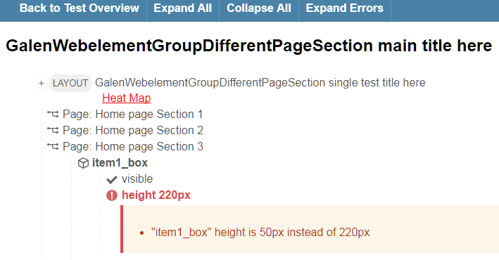
Reporting
In built reporting mechanism (demo using Java programming)
Sample test report using report.html
Heat map feature

Slide 9
